Slide 1
Pandemonium at a Viral Fishing Expedition
The personal challenges going into viral surveillance
Jalees Nasir
Biochem 3BP3
October 8, 2024

Slide 2
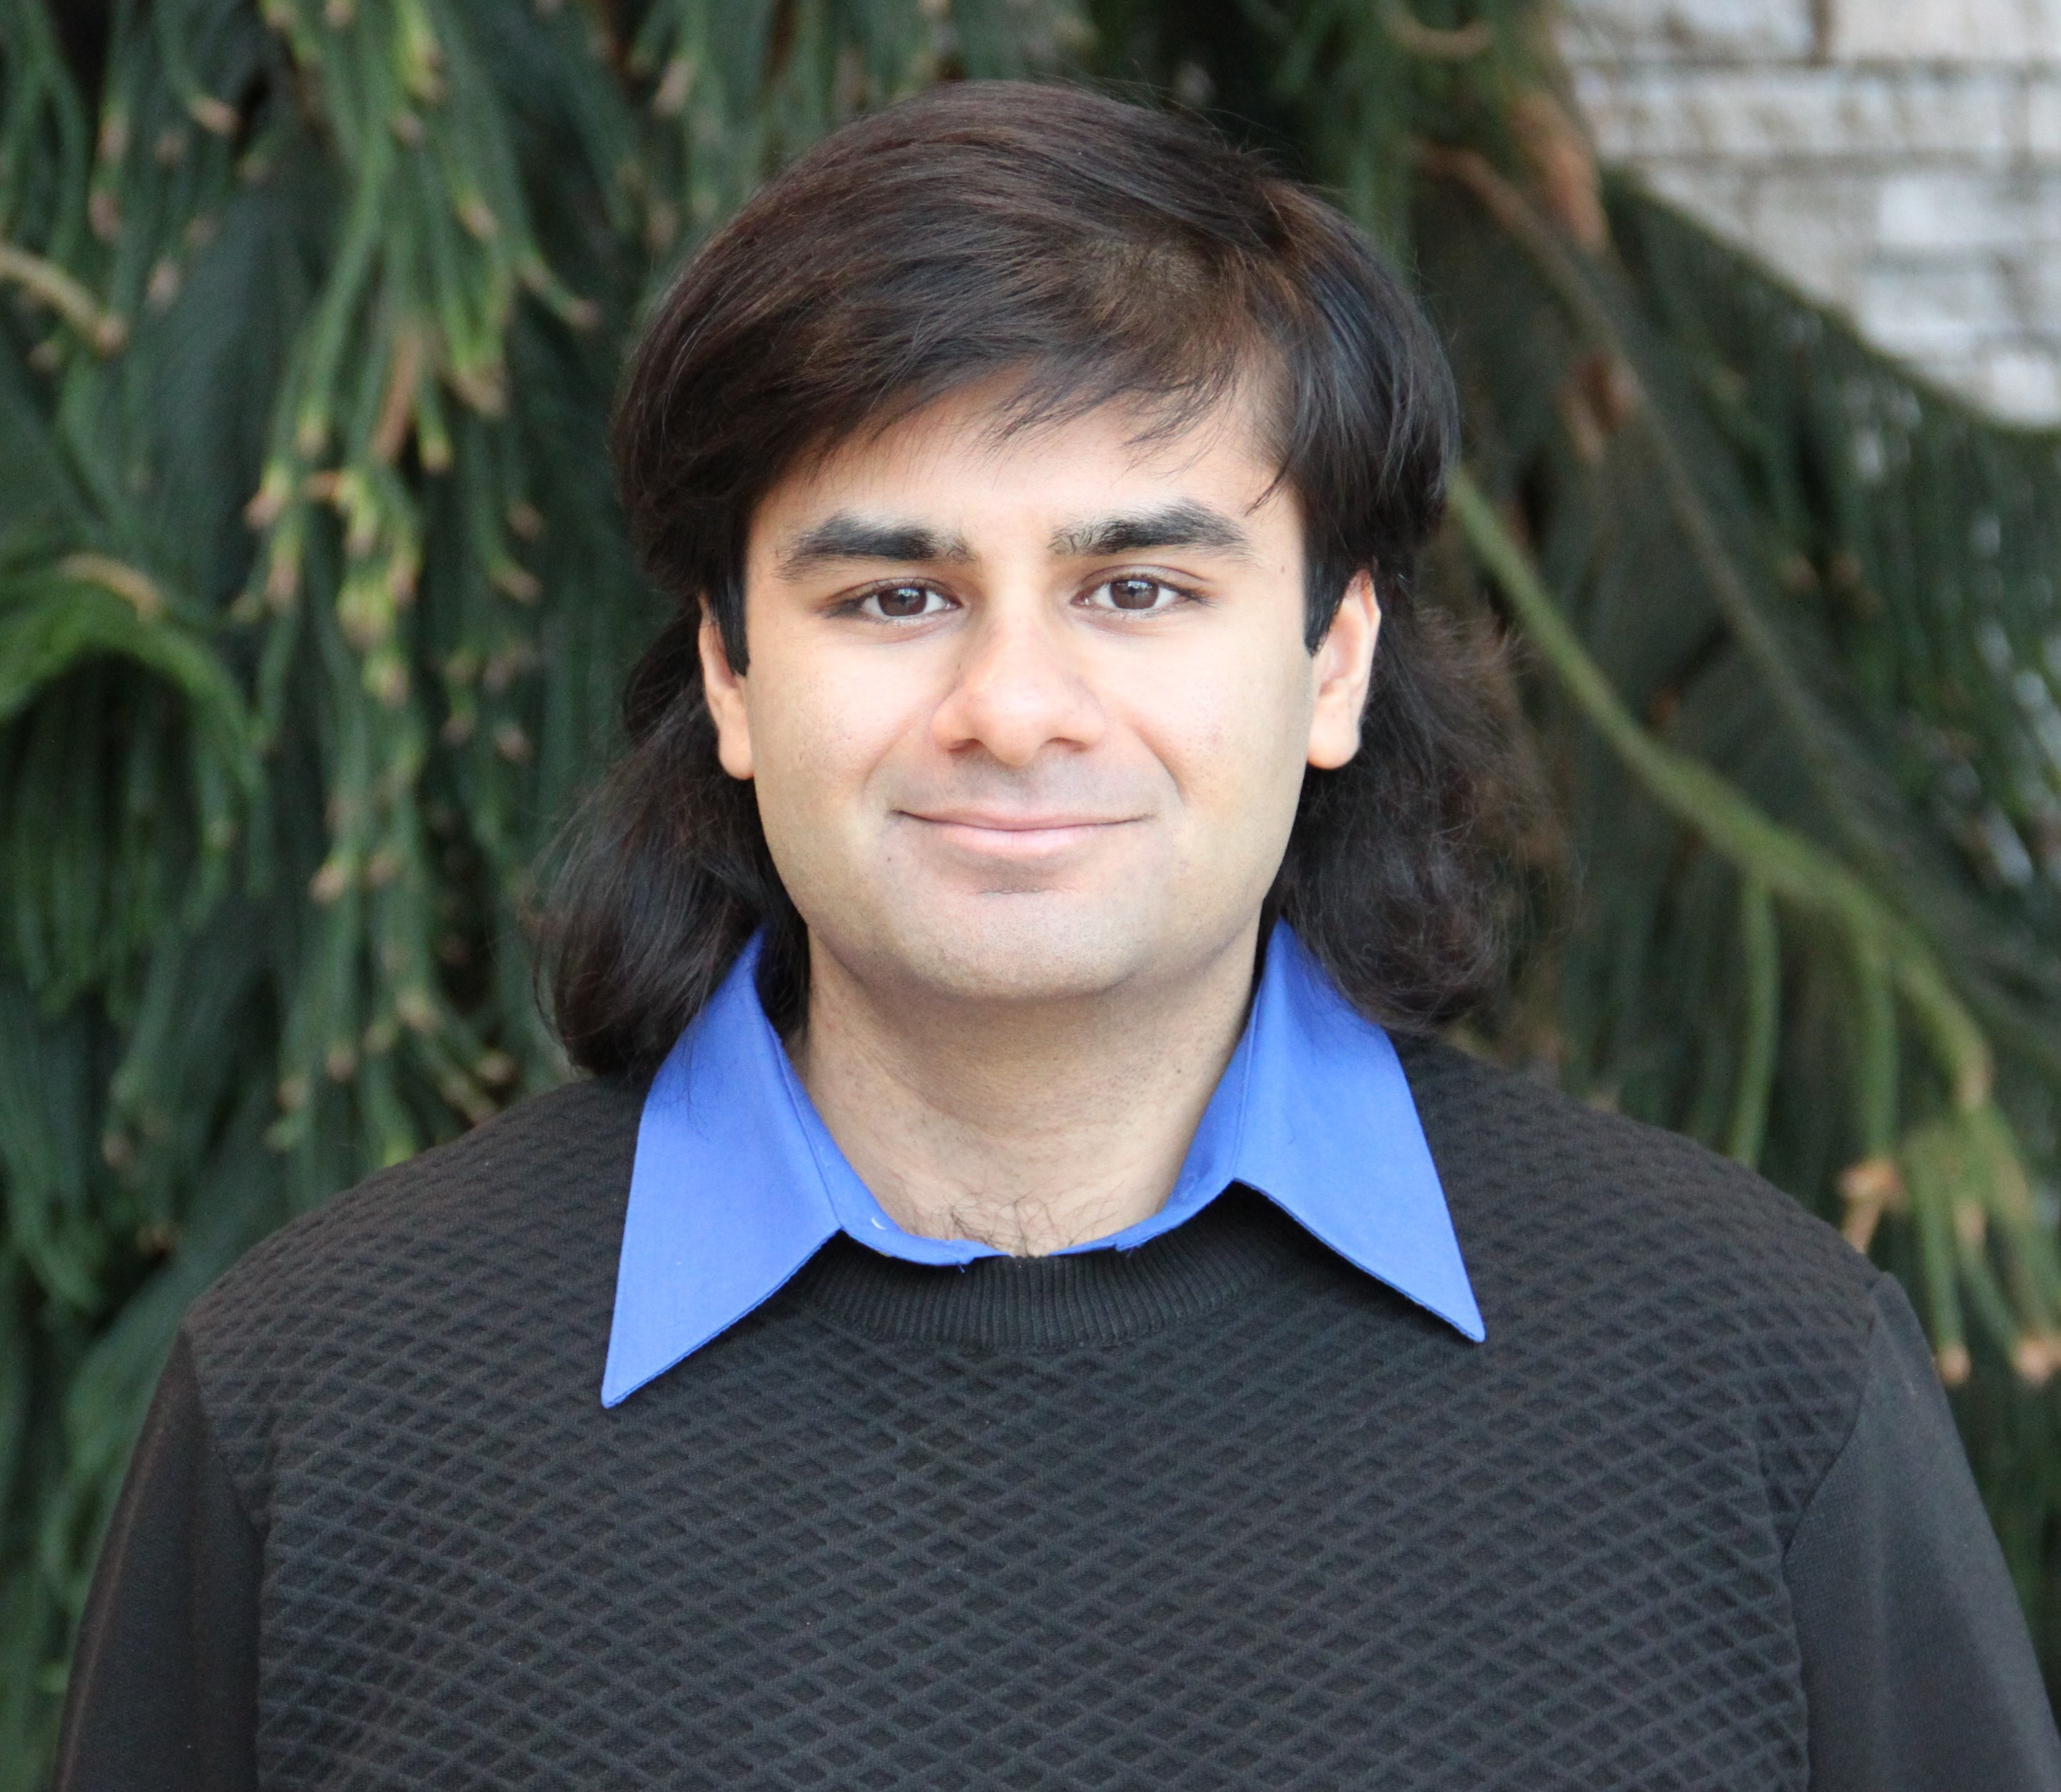
Me
2017
BSc. Chemical Biology
McMaster University
2018
Started MSc. Biochemistry
McMaster University
(McArthur Lab)
2019 – Present
PhD Biochemistry
McMaster University
(McArthur Lab)

Slide 3
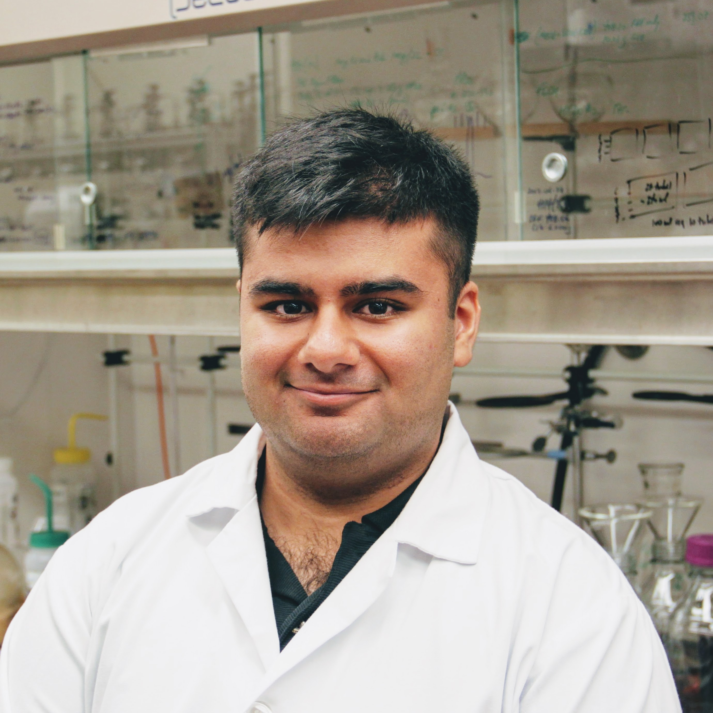

Me
2017
BSc. Chemical Biology
McMaster University
2017
Started MSc. Chemical Biology
McMaster University
“We want to be able to find and capture every single virus on the planet!”

Slide 4
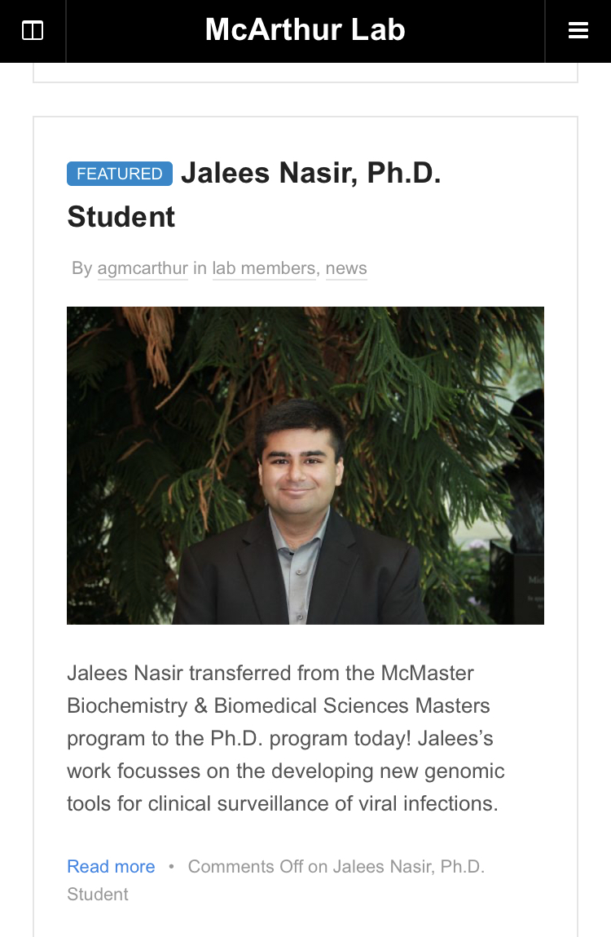
Me
2017
BSc. Chemical Biology
McMaster University
2017
Started MSc. Chemical Biology
McMaster University
2018
Started MSc. Biochemistry
McMaster University
(McArthur Lab)
2019-Present
PhD Biochemistry
McMaster University
(McArthur Lab)

Slide 5
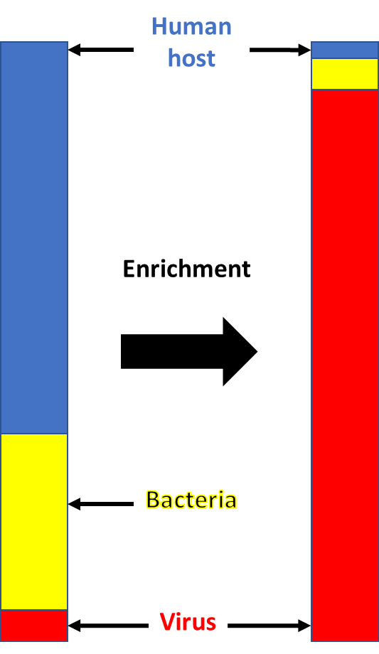
“We want to be able to find and capture every single virus on the planet!”

Slide 6
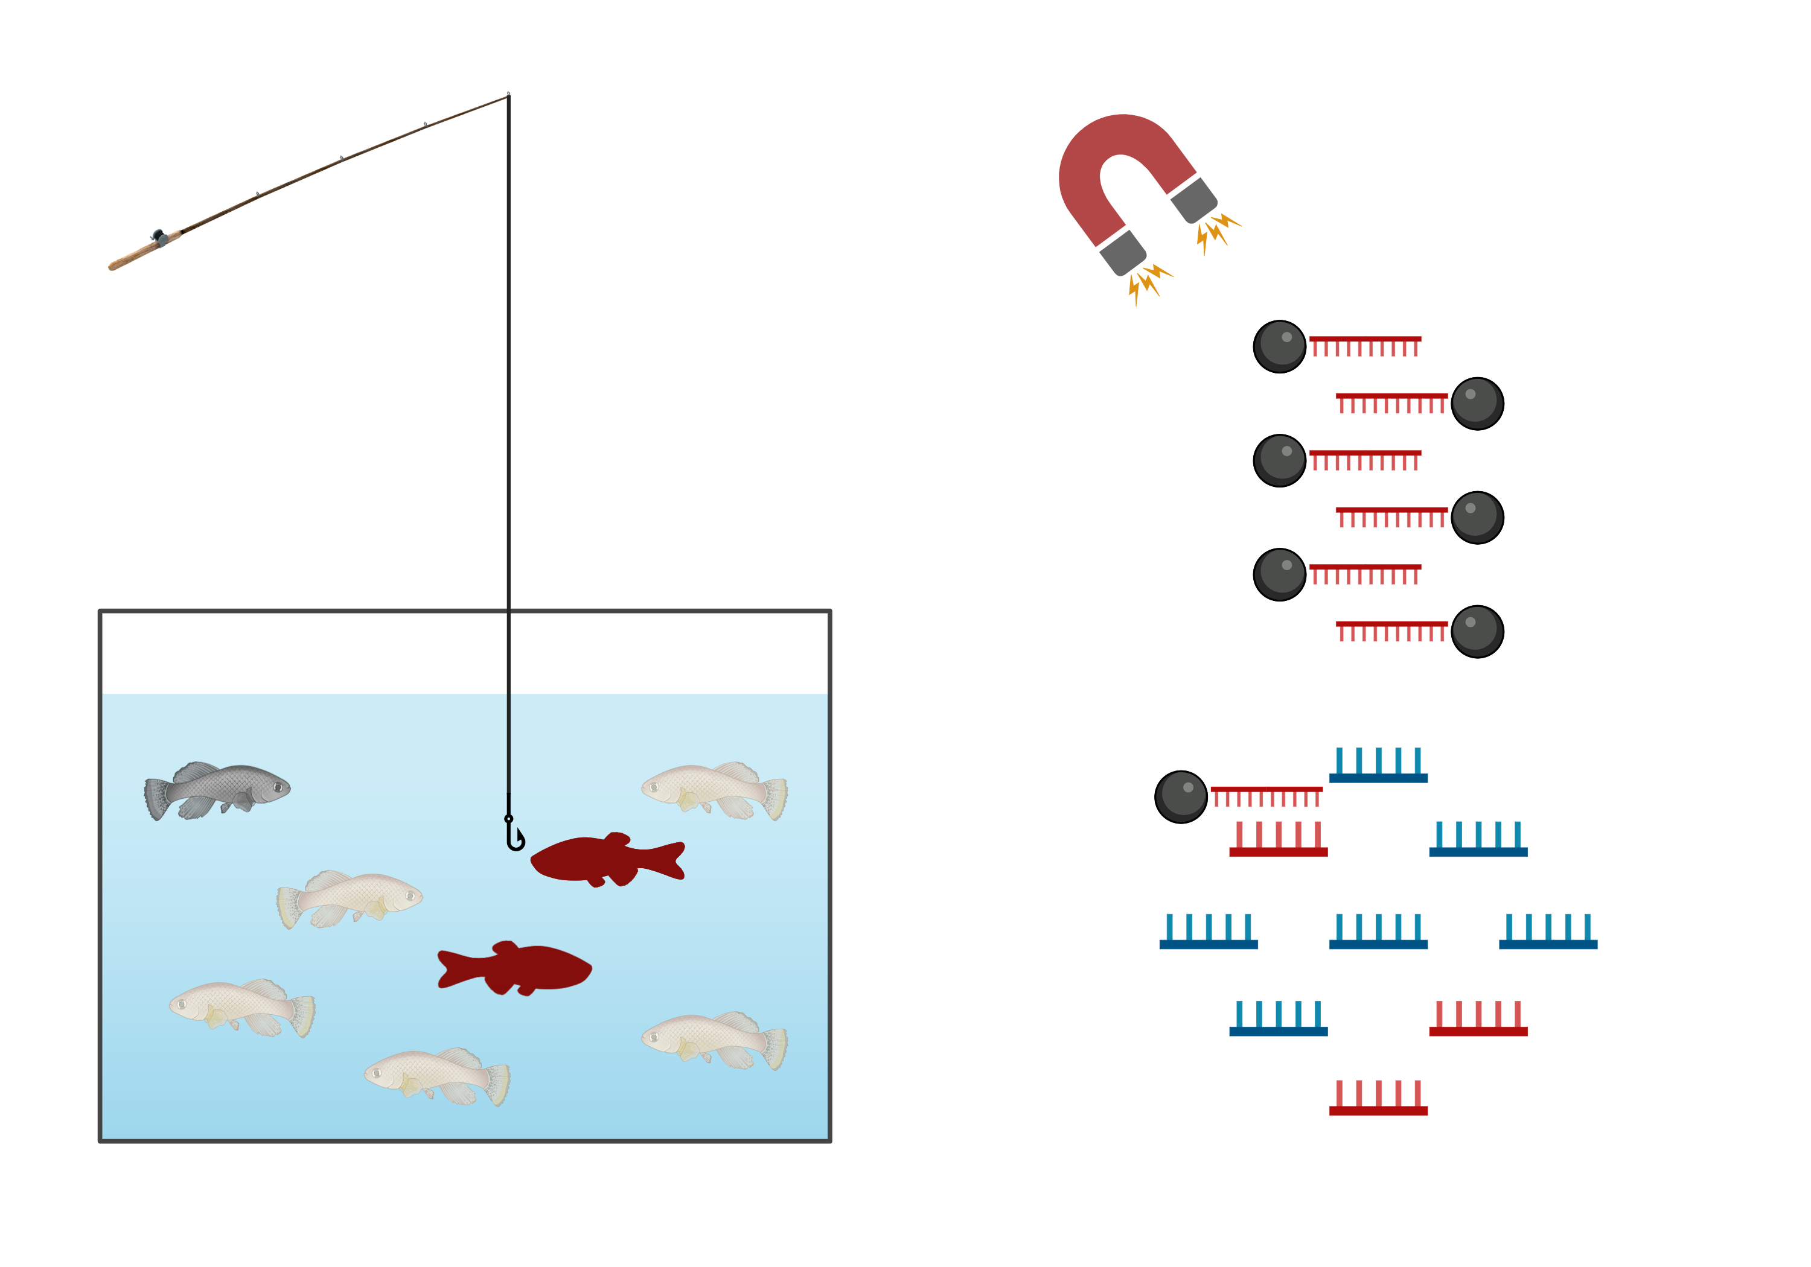
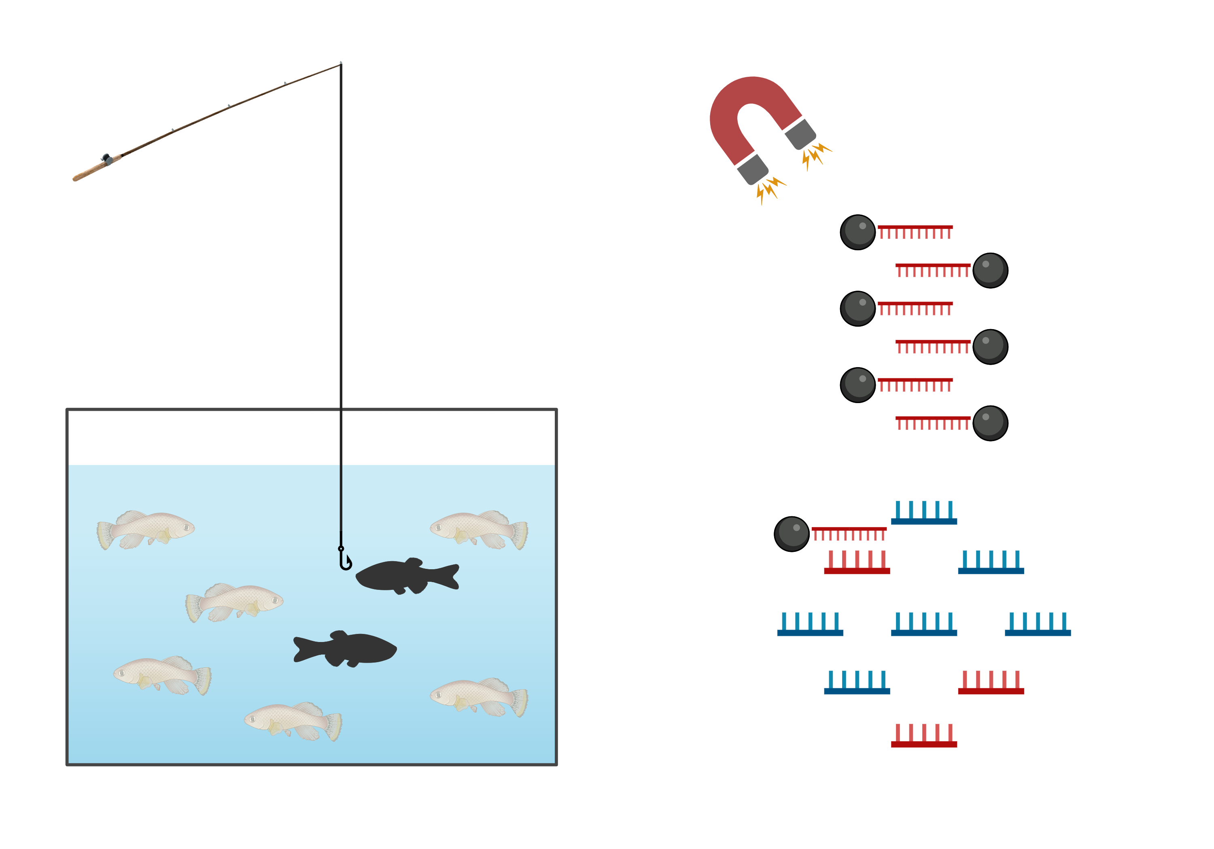
(3) Streptavidin -coated magnetic bead can reel in captured nucleotides
n
(1) Biotinylated hybridization probes (molecular fish hooks) added to a sample
(2) Molecular fishhooks anneal (hook) to target nucleotides

Slide 7
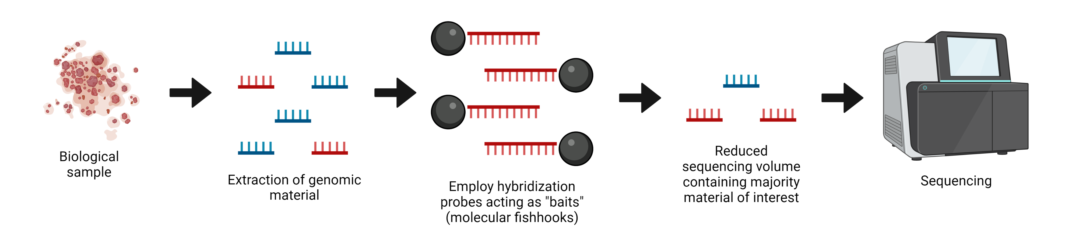
Bait capture solves two problems…
Reduced sequencing volume generally cuts sequencing costs
Unlike with PCR primers, you don’t need nearly perfect similarity to your target
However, synthesis costs become the new barrier

Slide 8
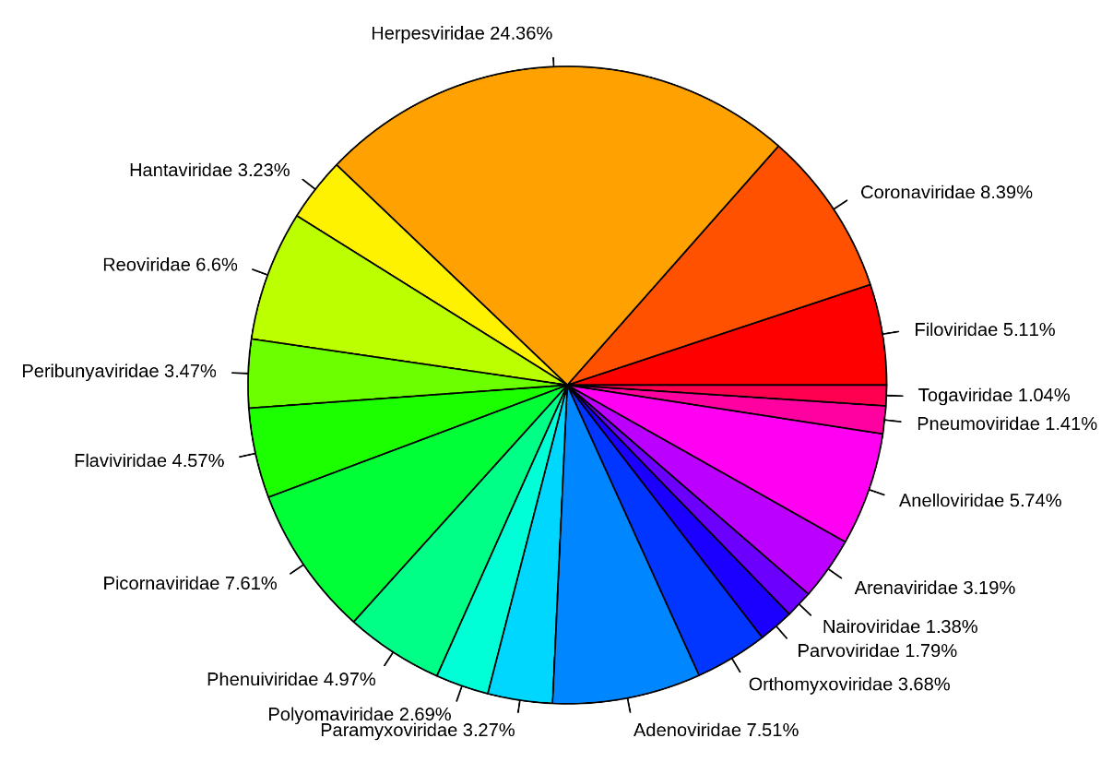
Broad Viral Capture
Human Respiratory Whole Genome Capture Set:
Offset
Length
3+ million virus genome sequences
Repeating tiling → 85+ million putative baits
Broad-target sets aim to capture more viruses with less
Focuses initially on respiratory viruses as not all have existing diagnostic tools
Added logic follows known symptomology (rooted in clinical epidemiology)
N = 96,166 baits
Targets 19 virus families known for respiratory (or respiratory-associated) infection

Slide 9
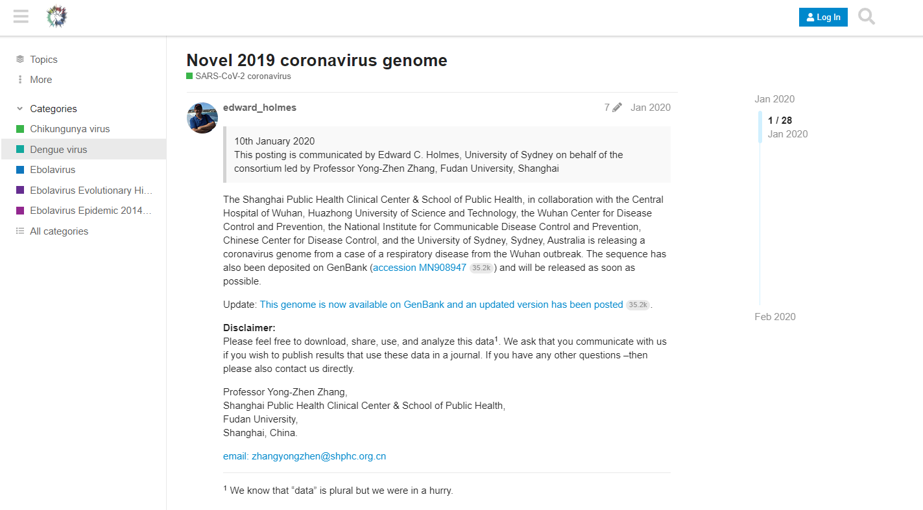
January 10, 2020:
The first sequence associated with the novel coronavirus first reported out of Wuhan, China was publicly released on Virological.org → GenBank
https://virological.org/t/novel-2019-coronavirus-genome/319

Slide 10
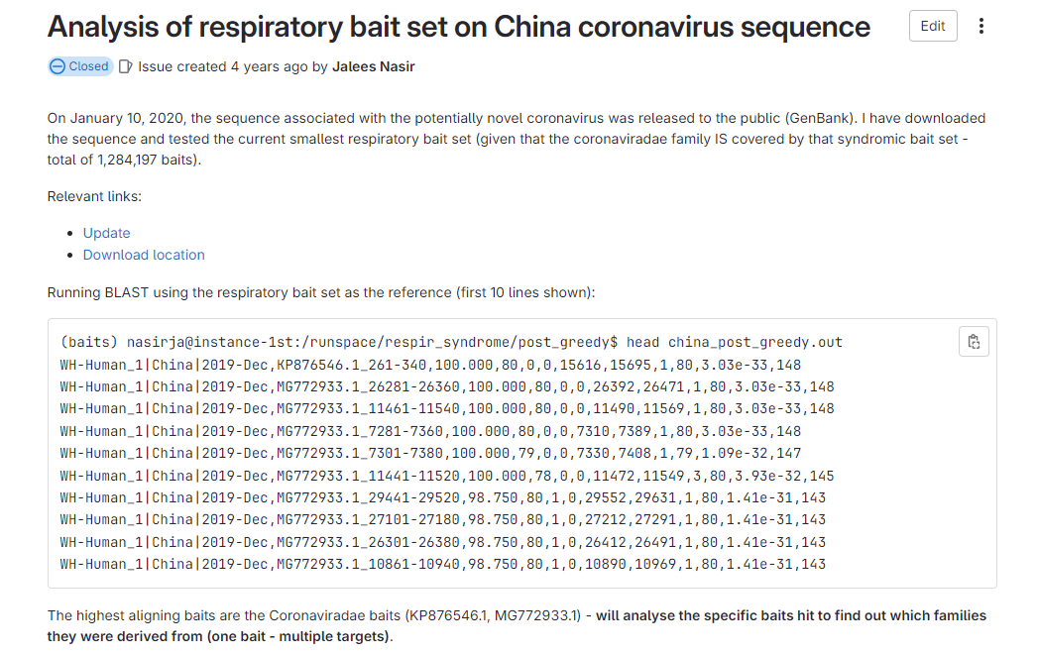
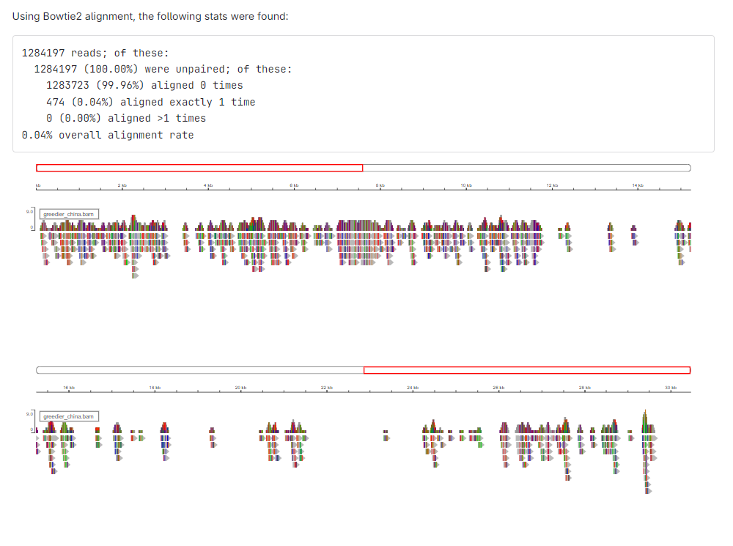
Very small proportion of the set aligns
Estimated 0.4% of all Coronaviridae-linked bait sequences aligned
January 11, 2020:
I test a crude bait set (1+ million molecular fish hooks) and demonstrate the best HSPs were linked with Coronaviridae genomes

Slide 11
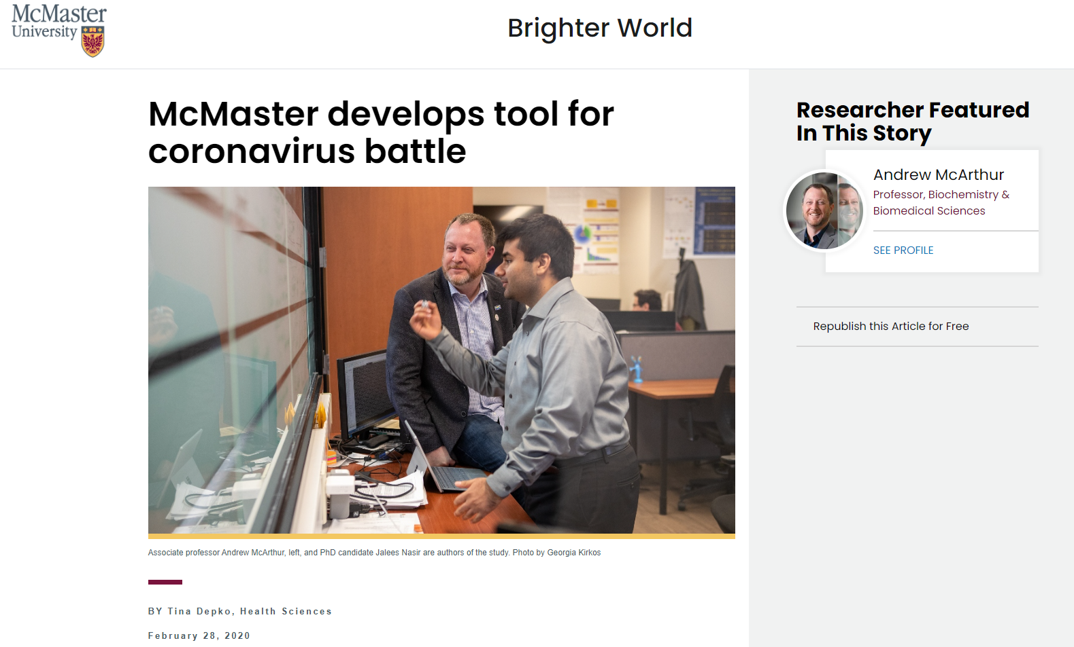
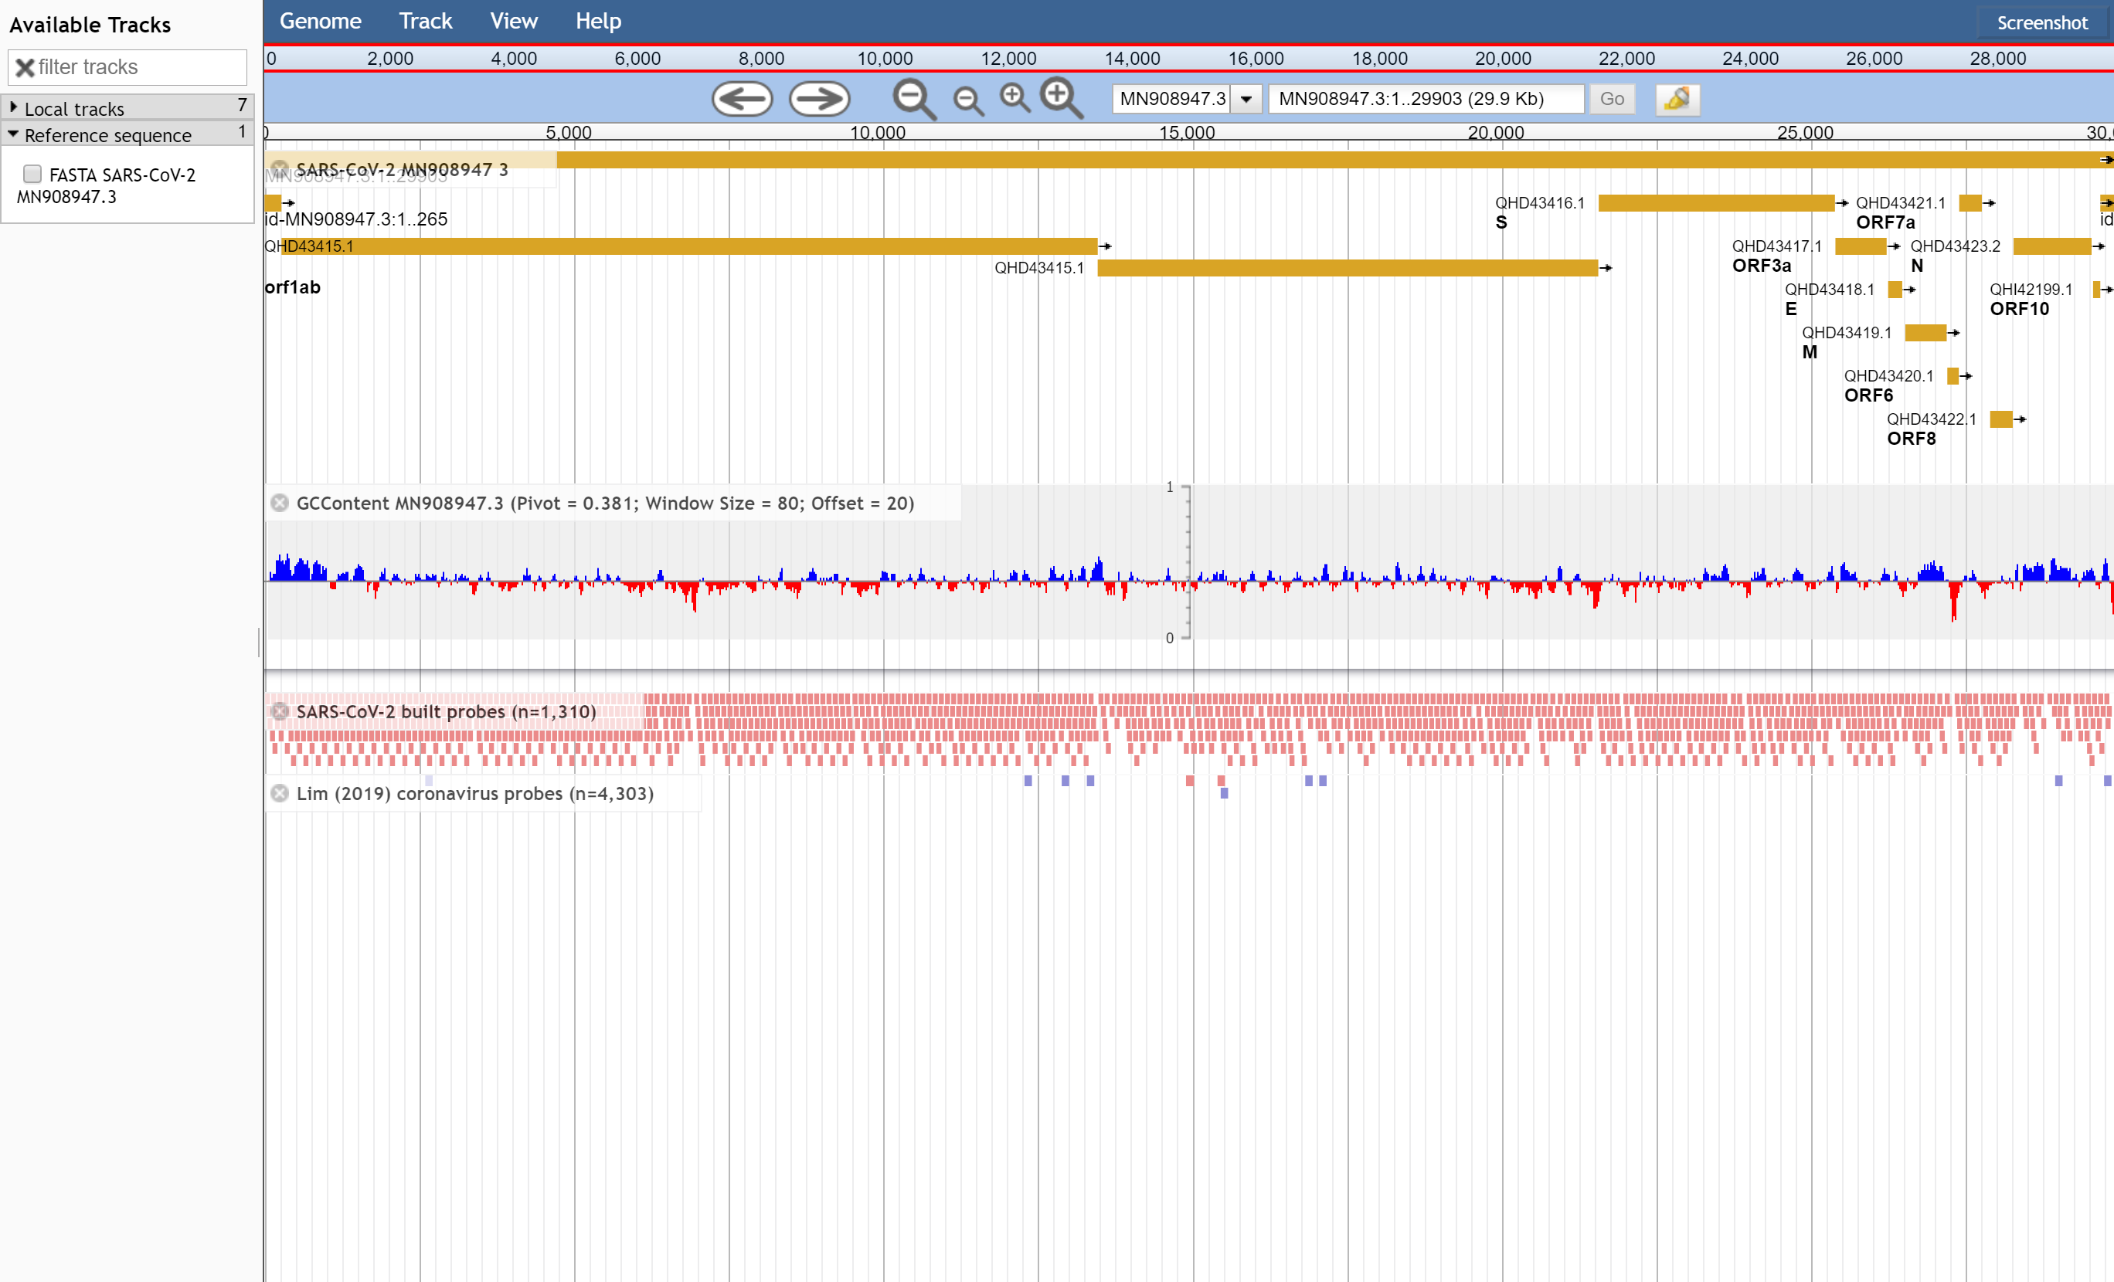
SARS-CoV-2 Bait Capture
https://github.com/jaleezyy/covid-19-baits
A total of 1,310 80-mer “fish hooks” focusing on SARS-CoV-2
Average depth of coverage = 3.4x across examined genomes
Published in August 2019 that claimed that the bait set could capture novel Coronaviruses
Nasir et al. 2020. Preprints 2020, 2020020385.

Slide 12
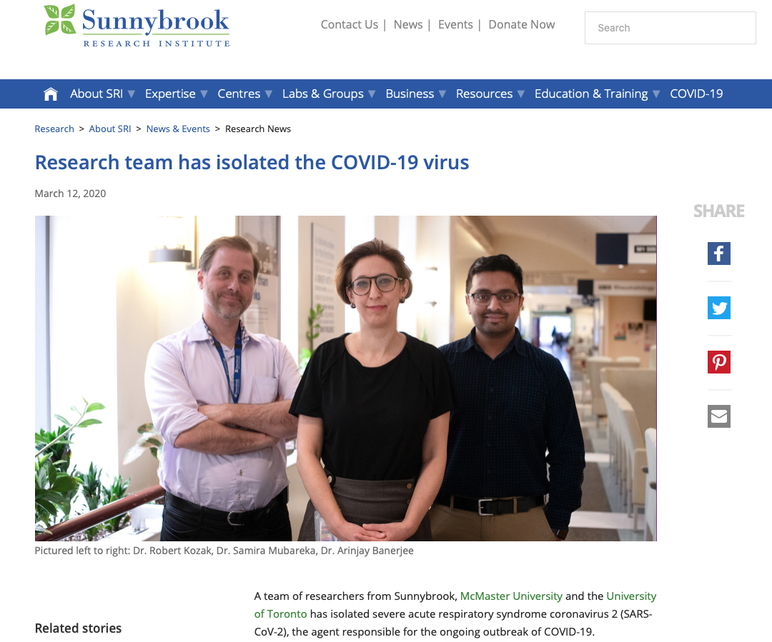

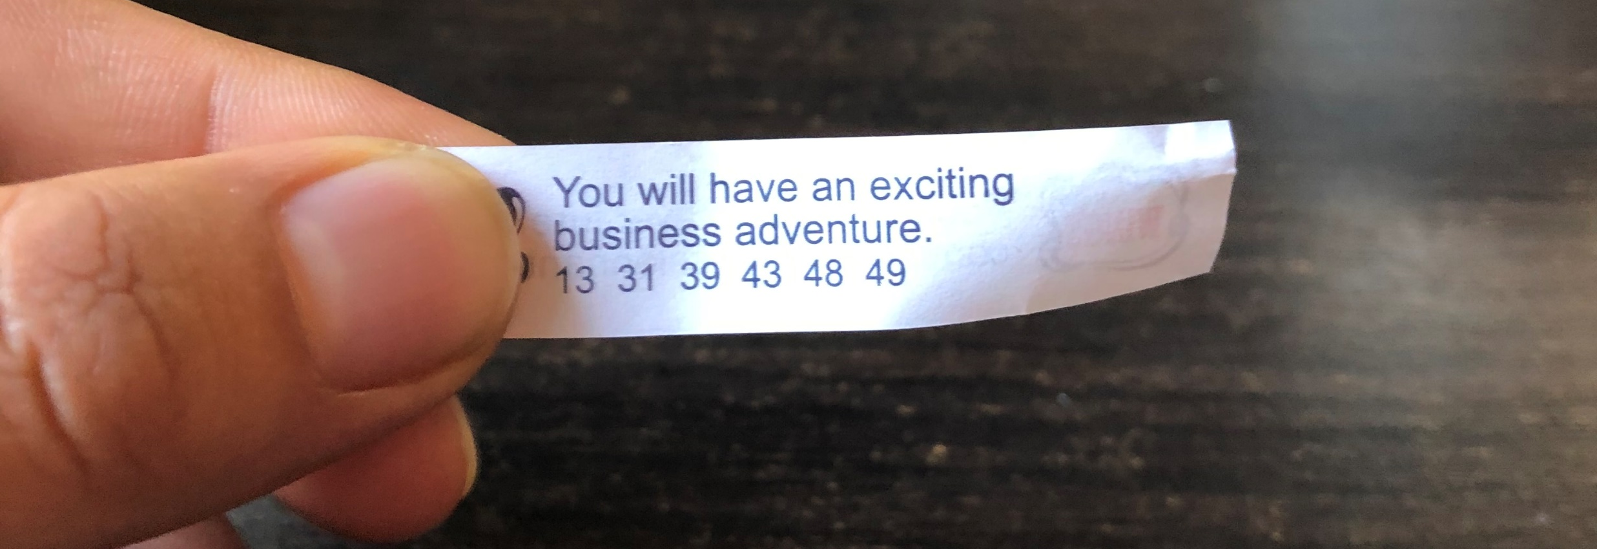
h

Slide 13
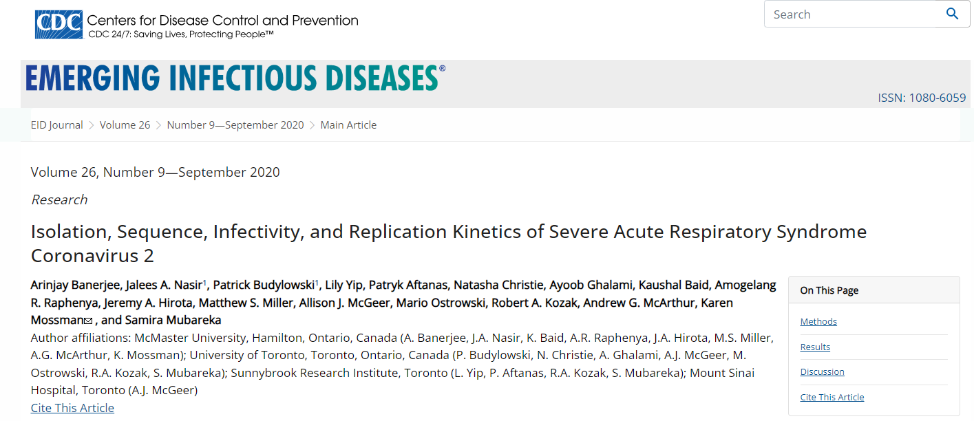
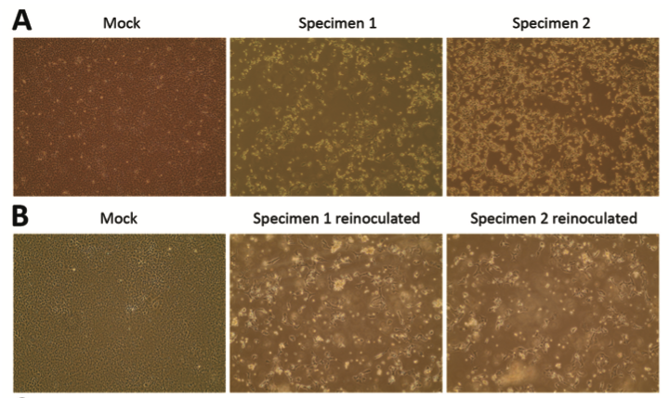
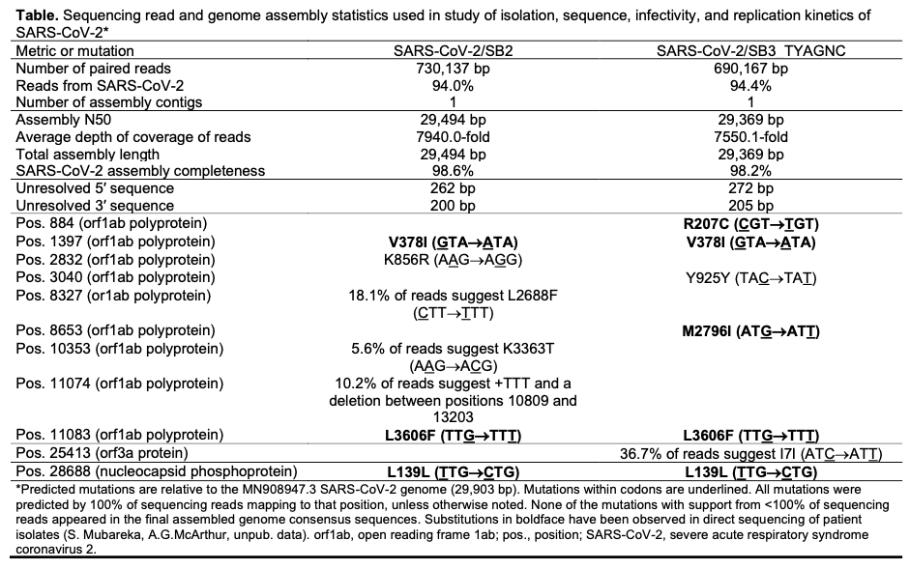
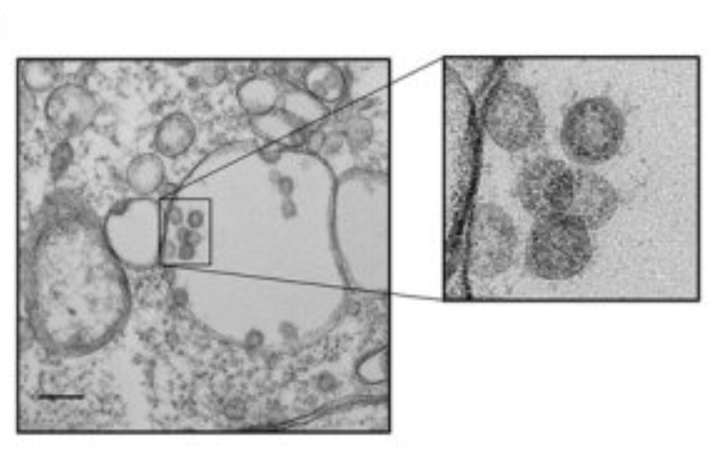
`
Banerjee et al. 2020. Emerging Infectious Diseases, 26, 2054-2063.

Slide 14
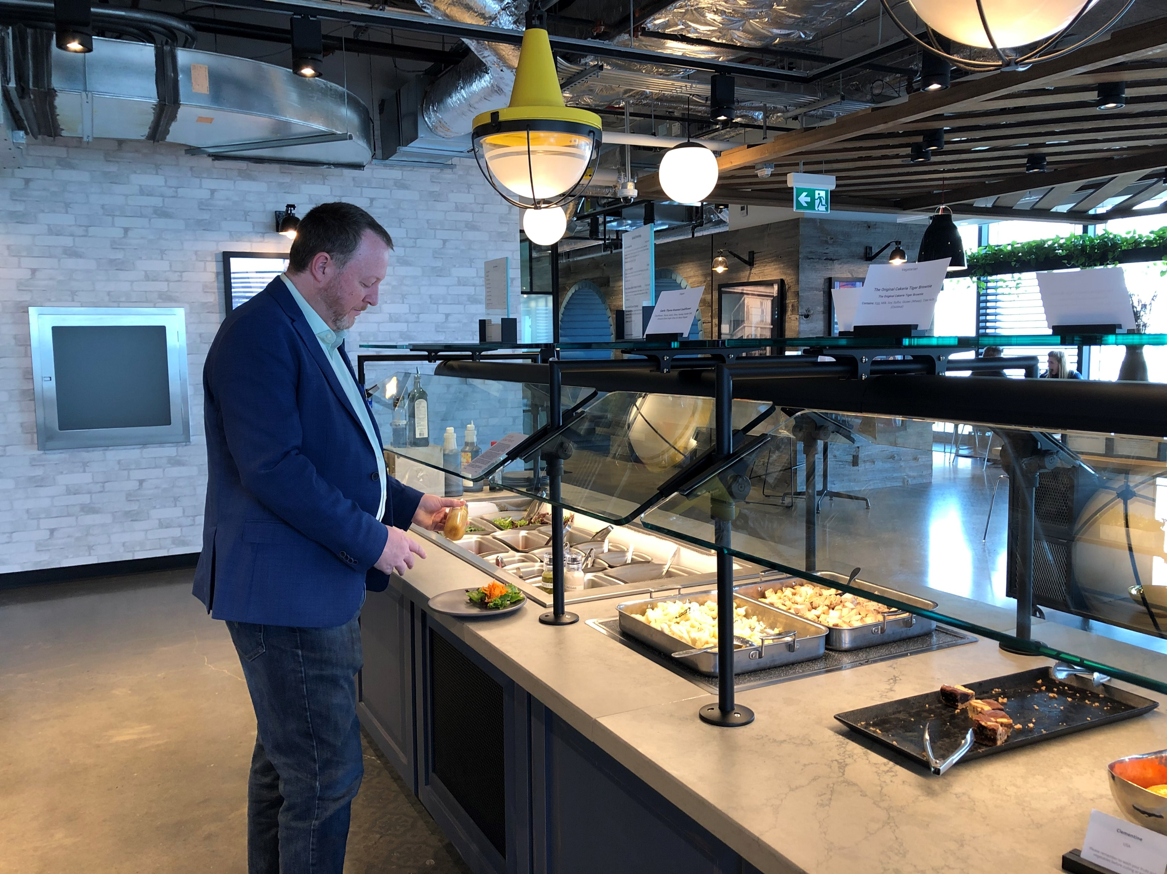
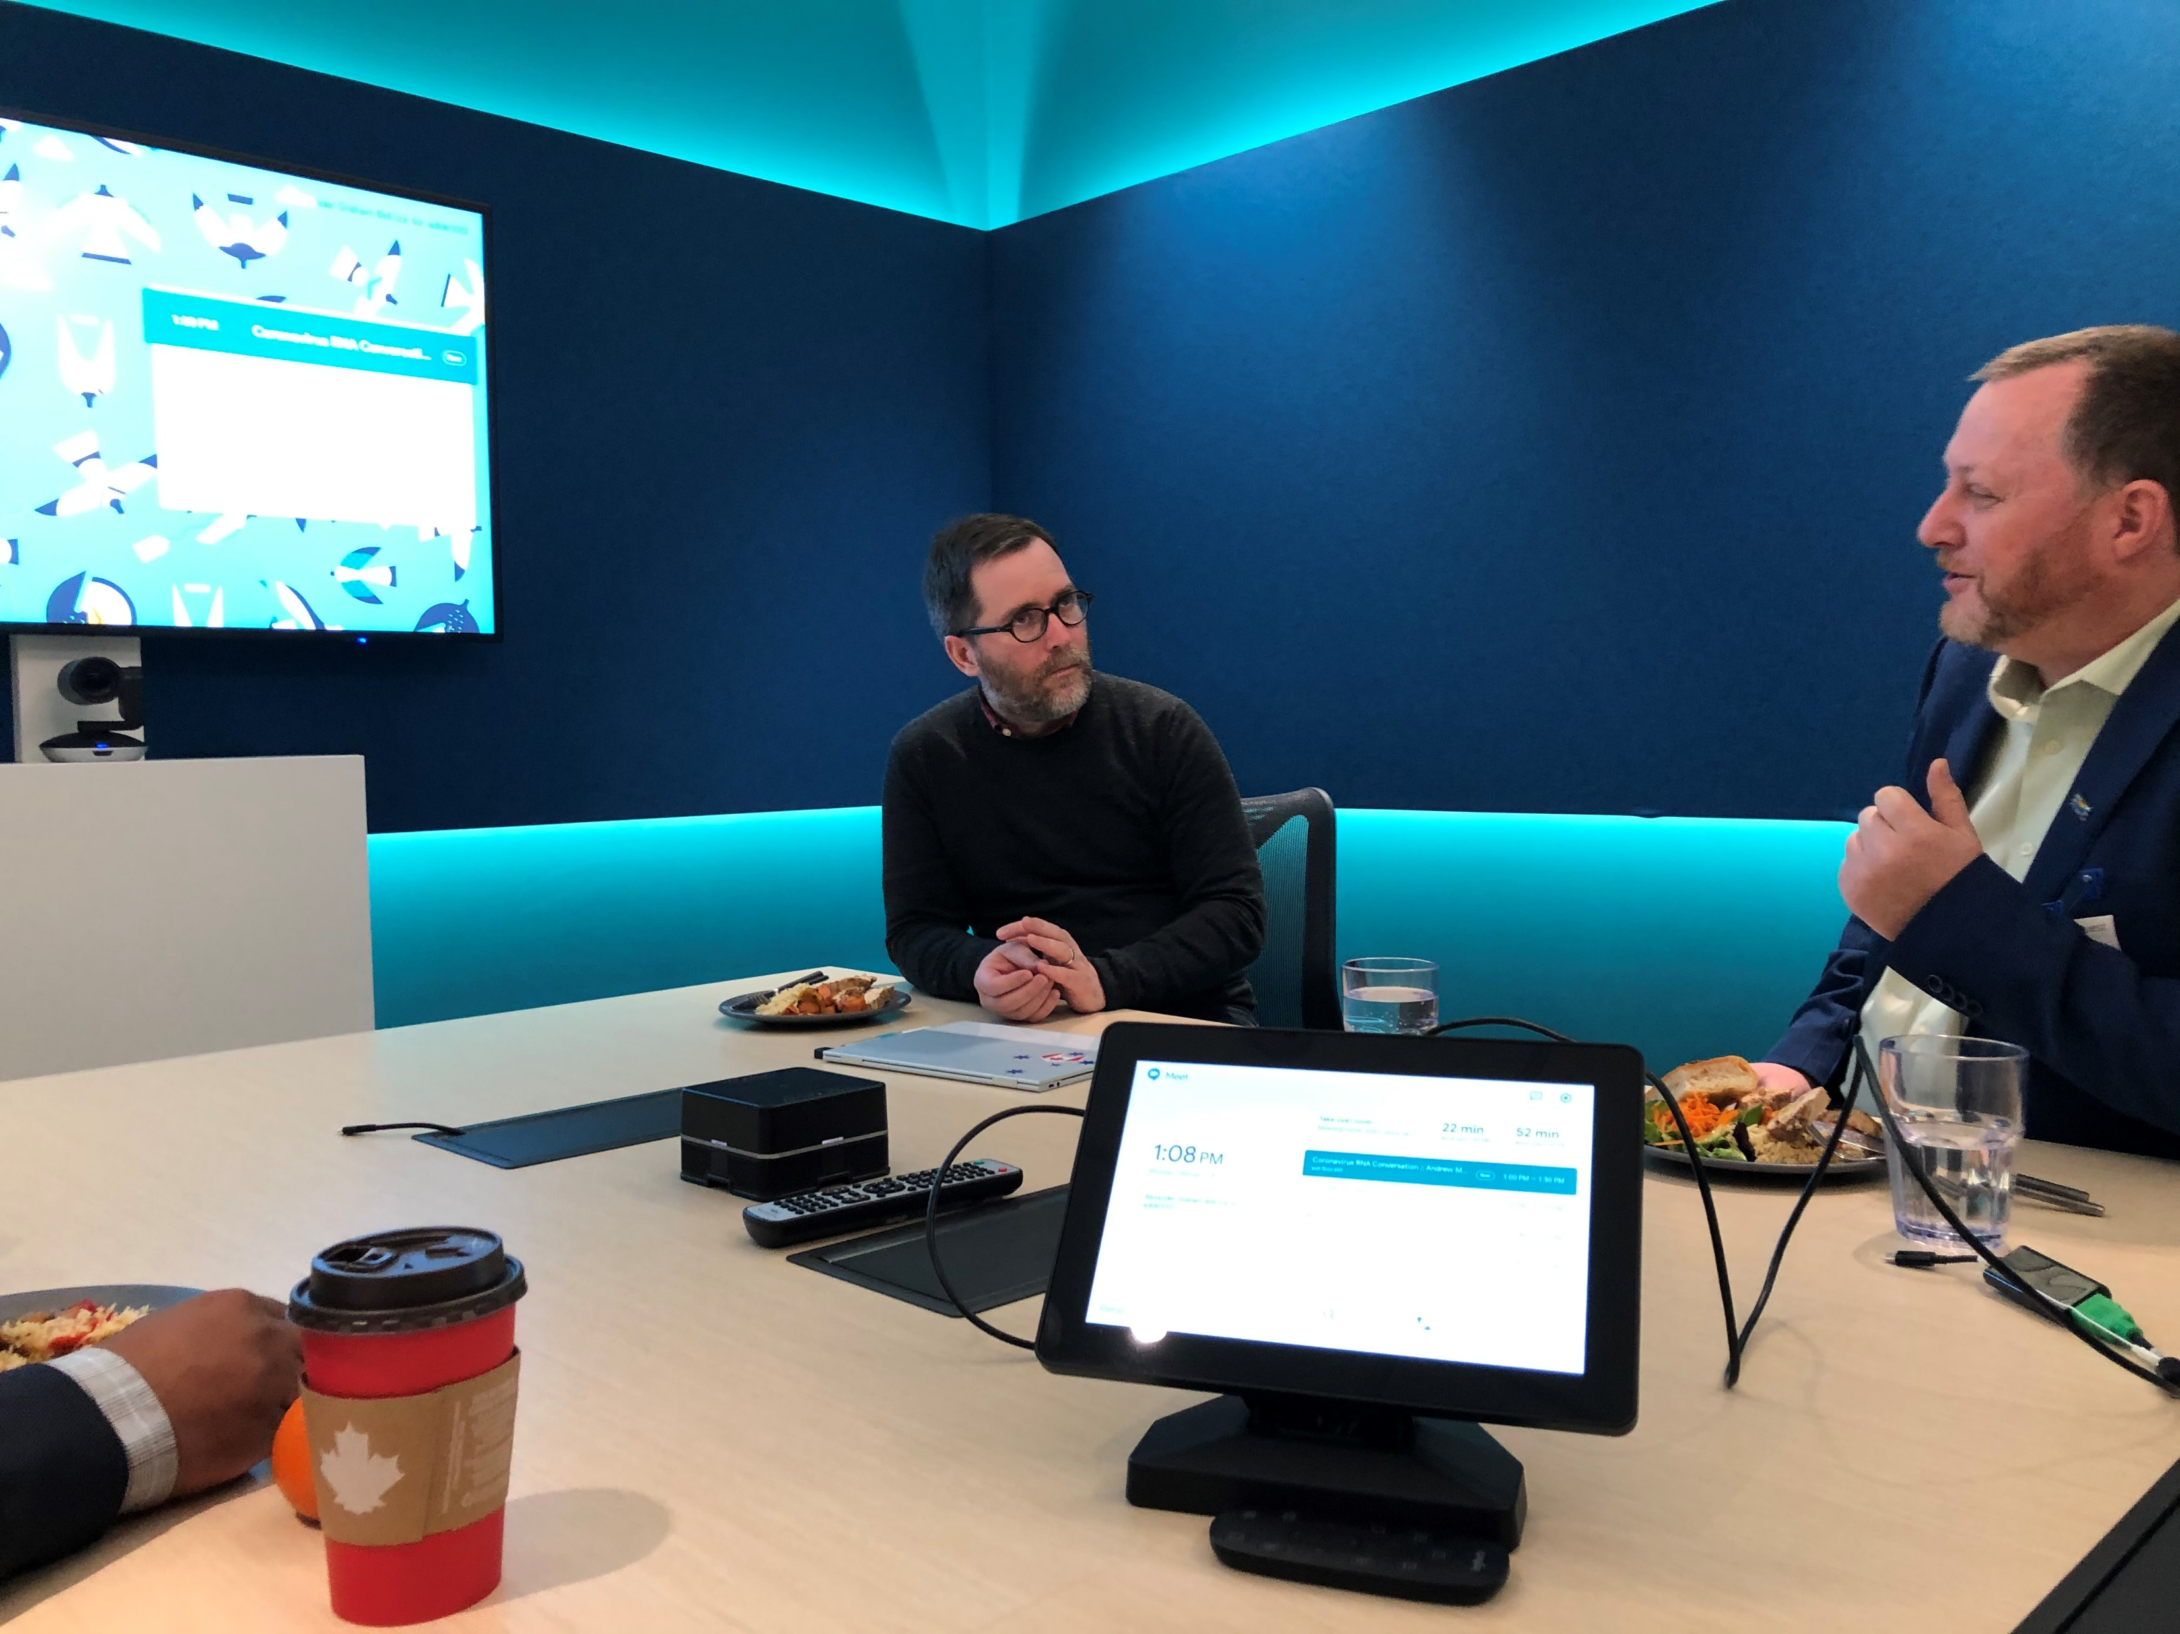
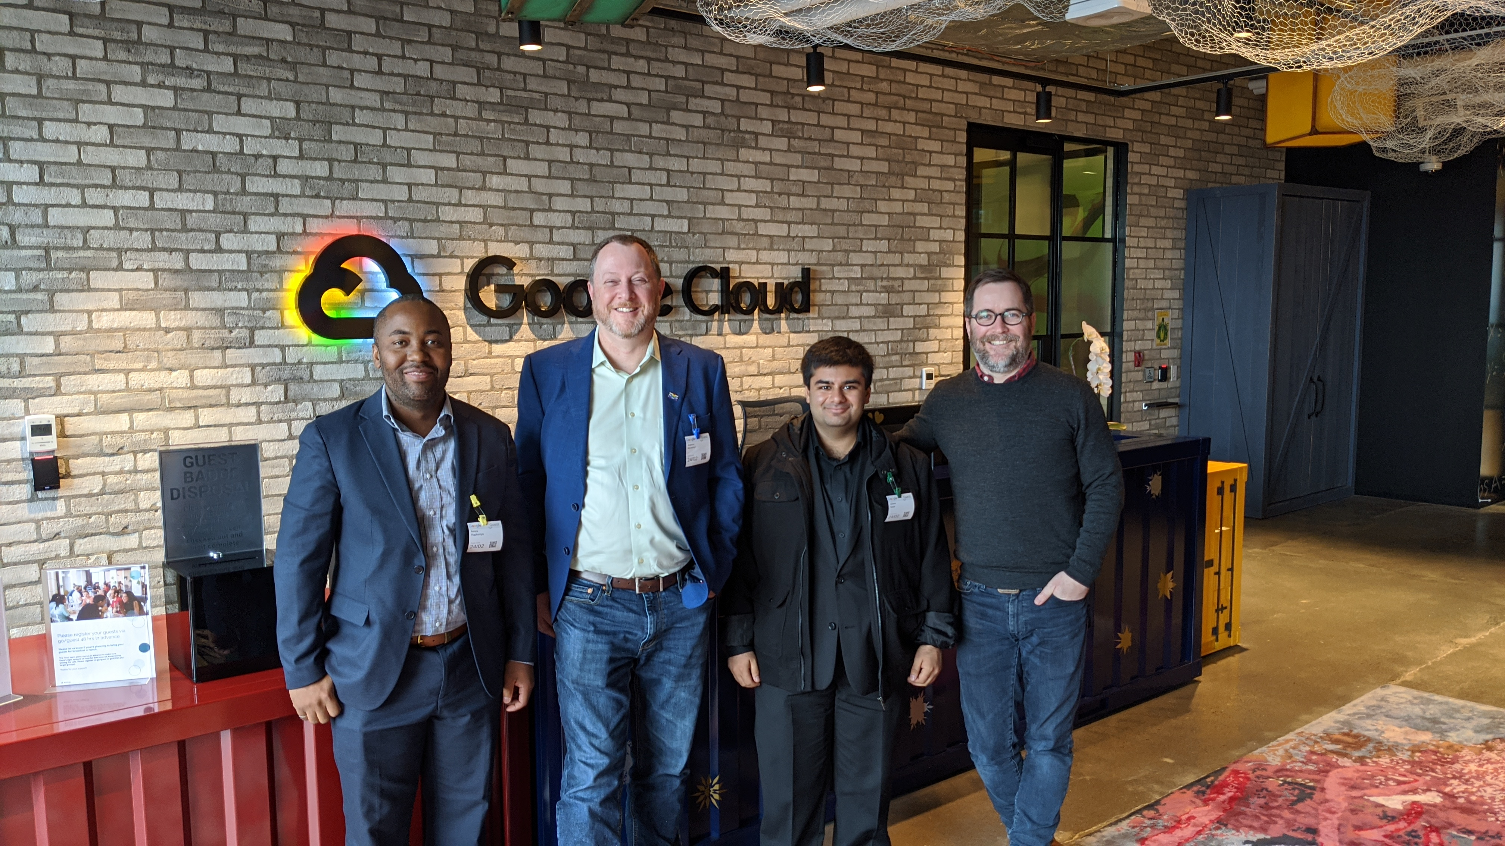
f

Slide 15
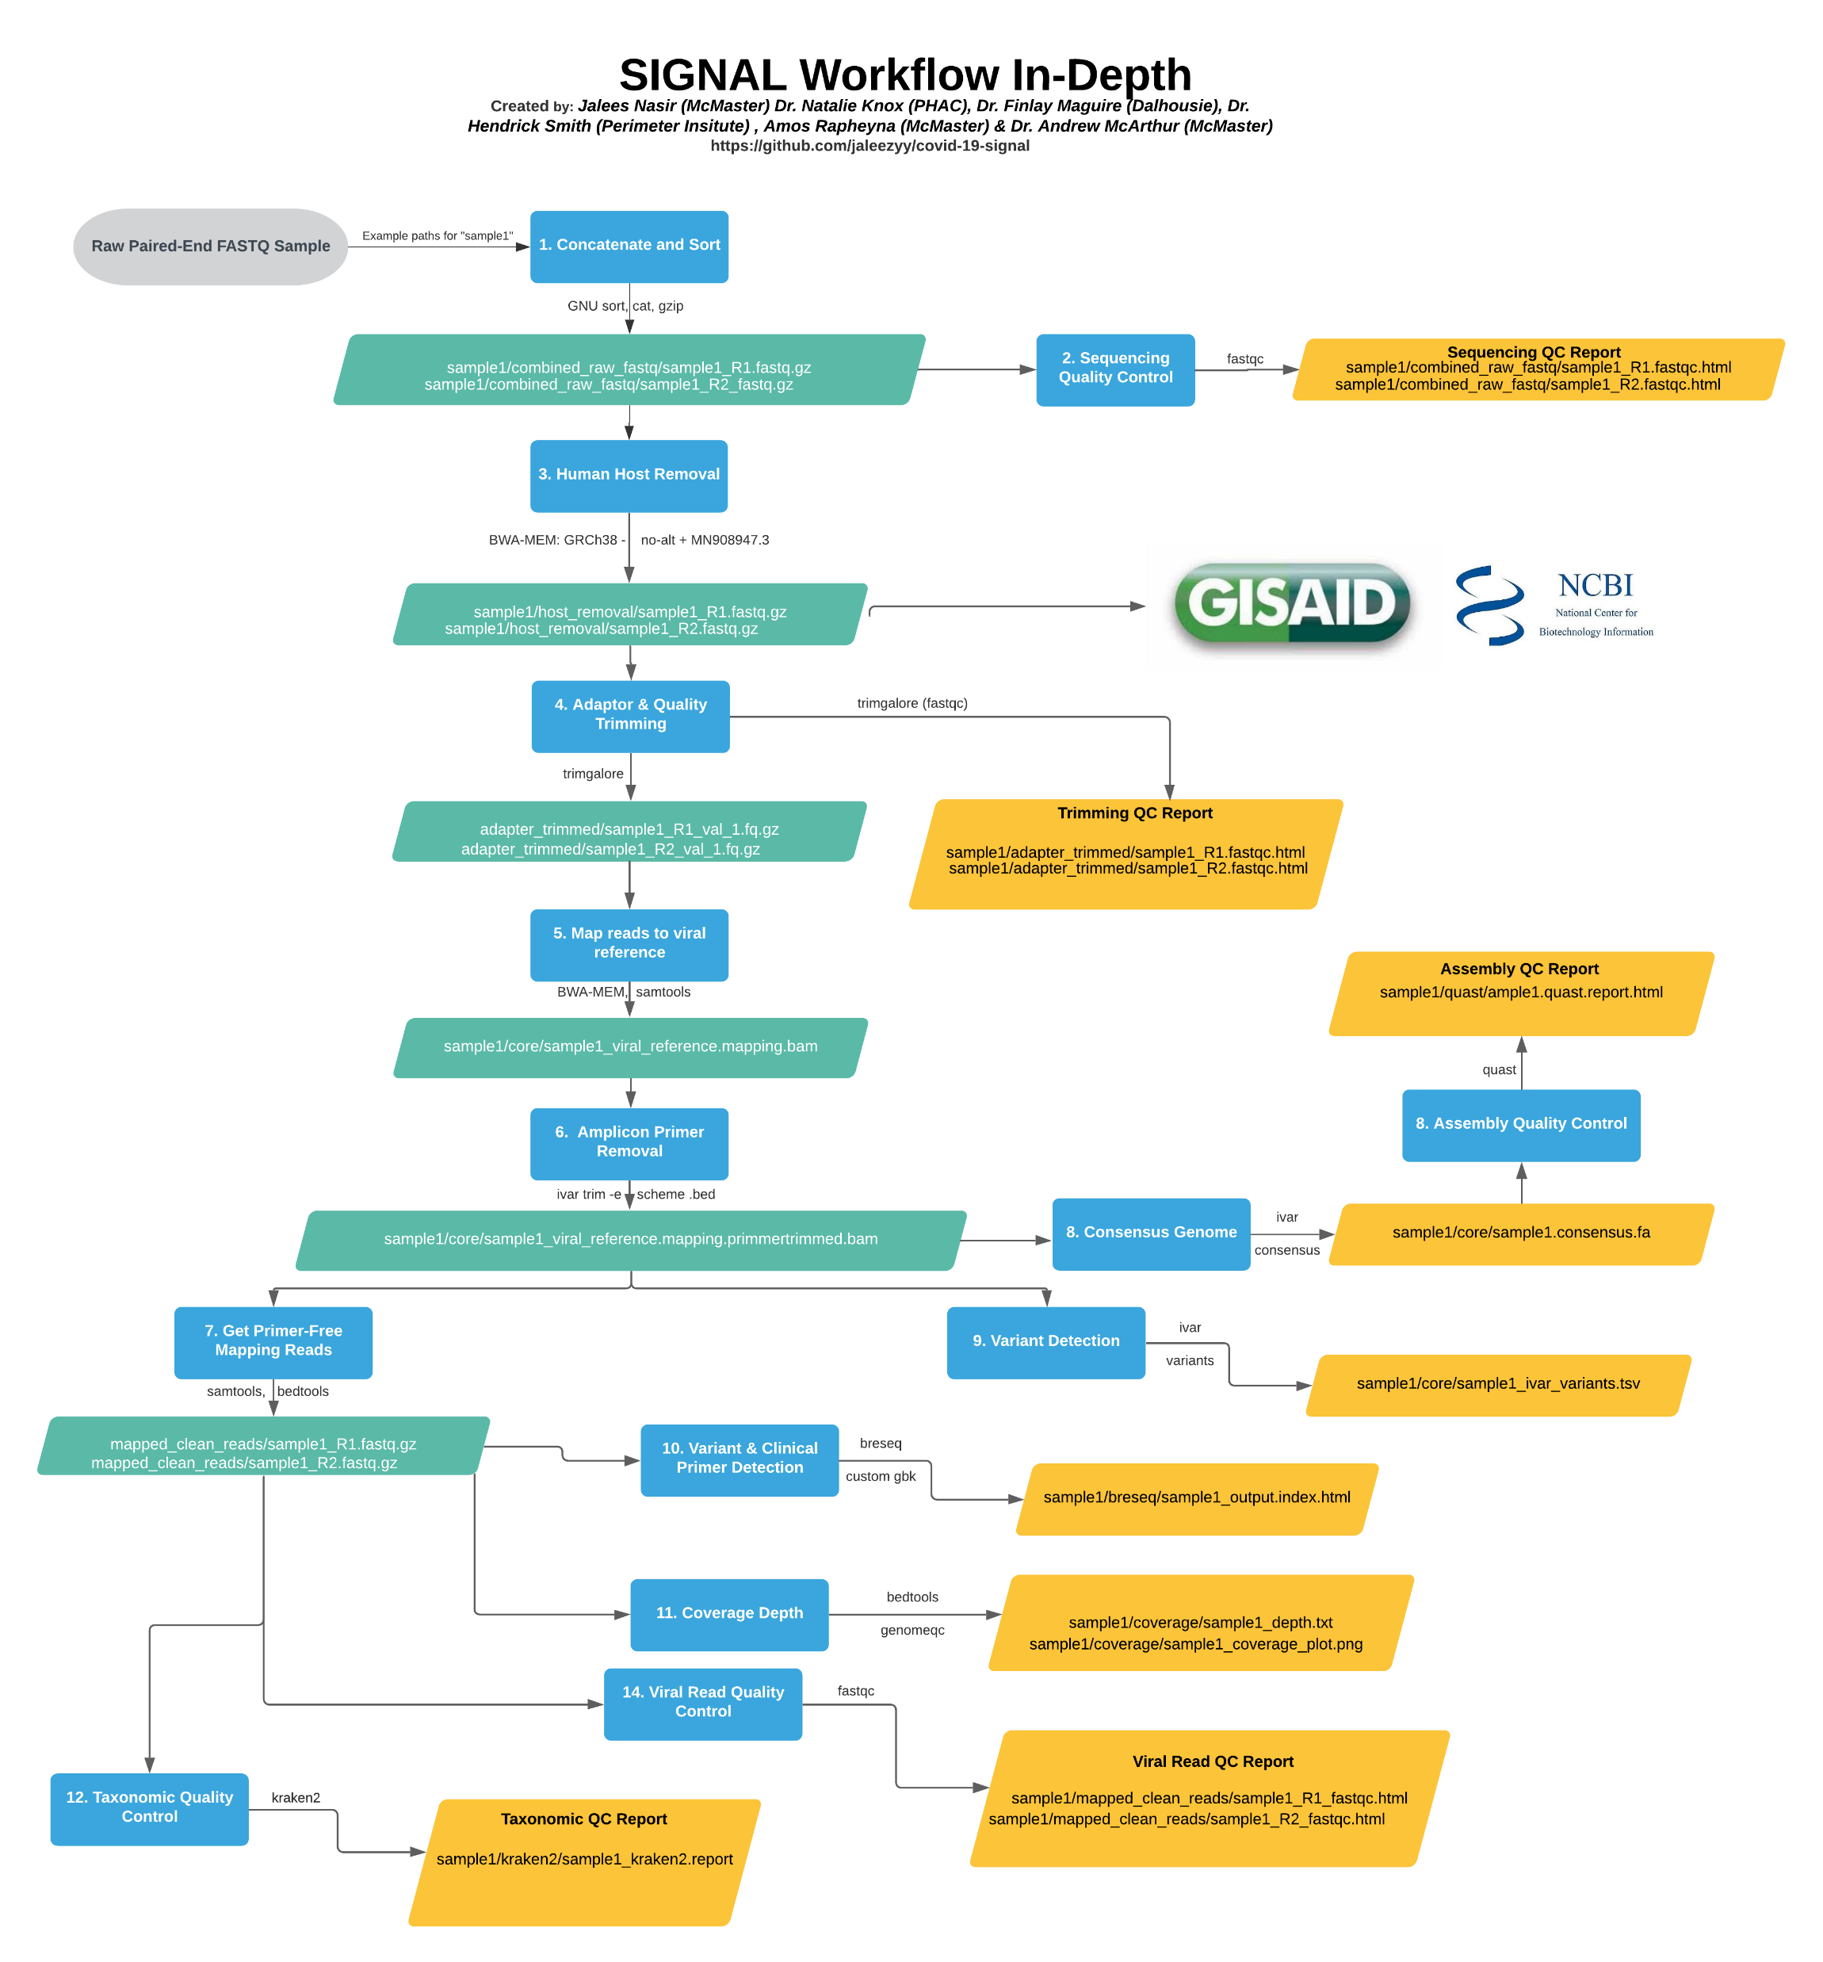
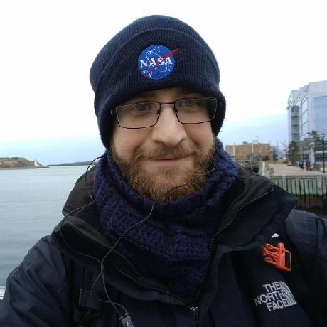
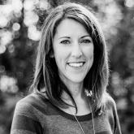
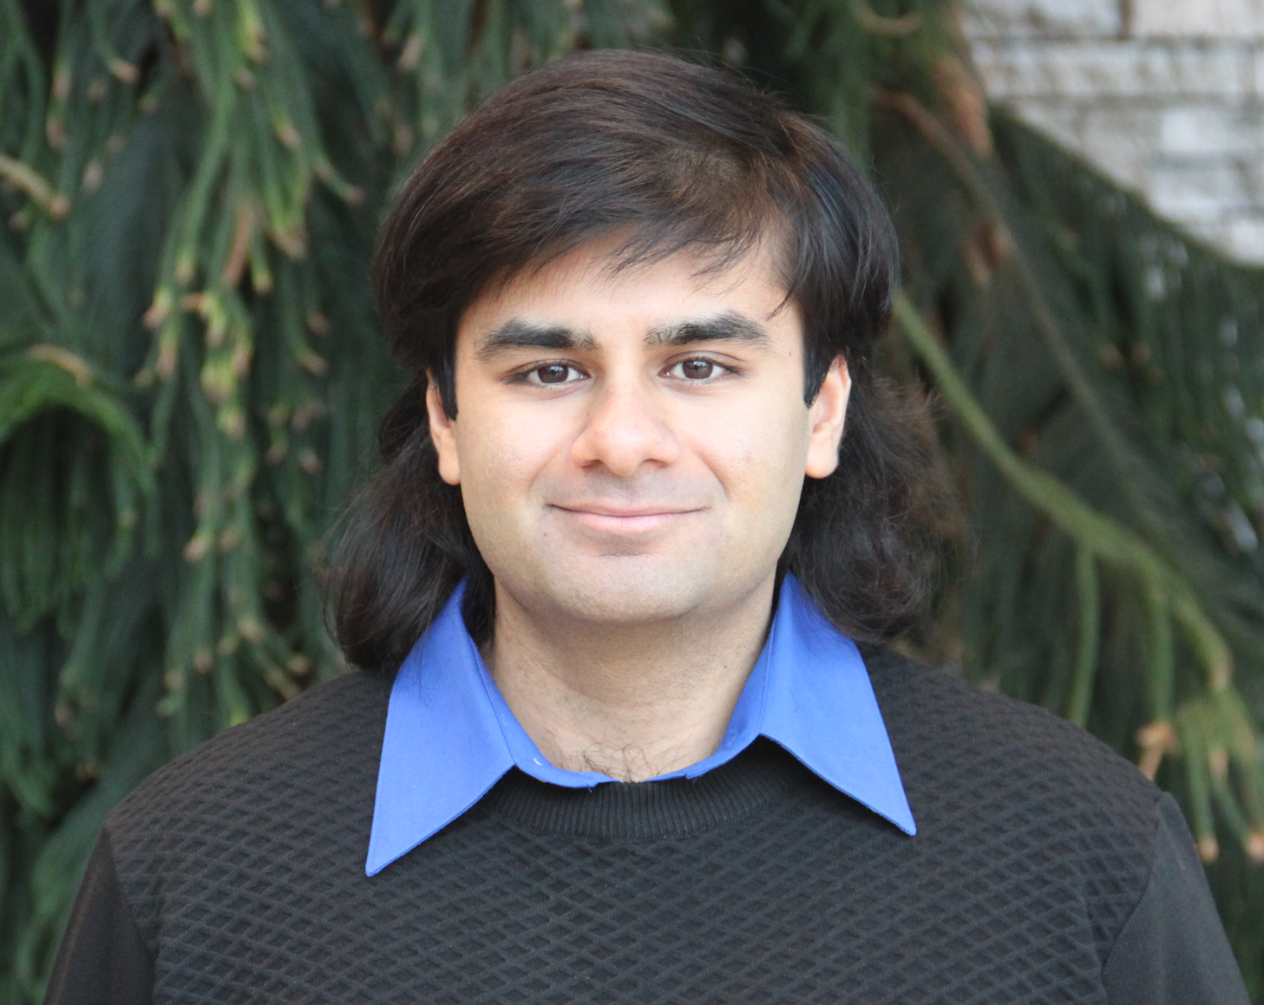
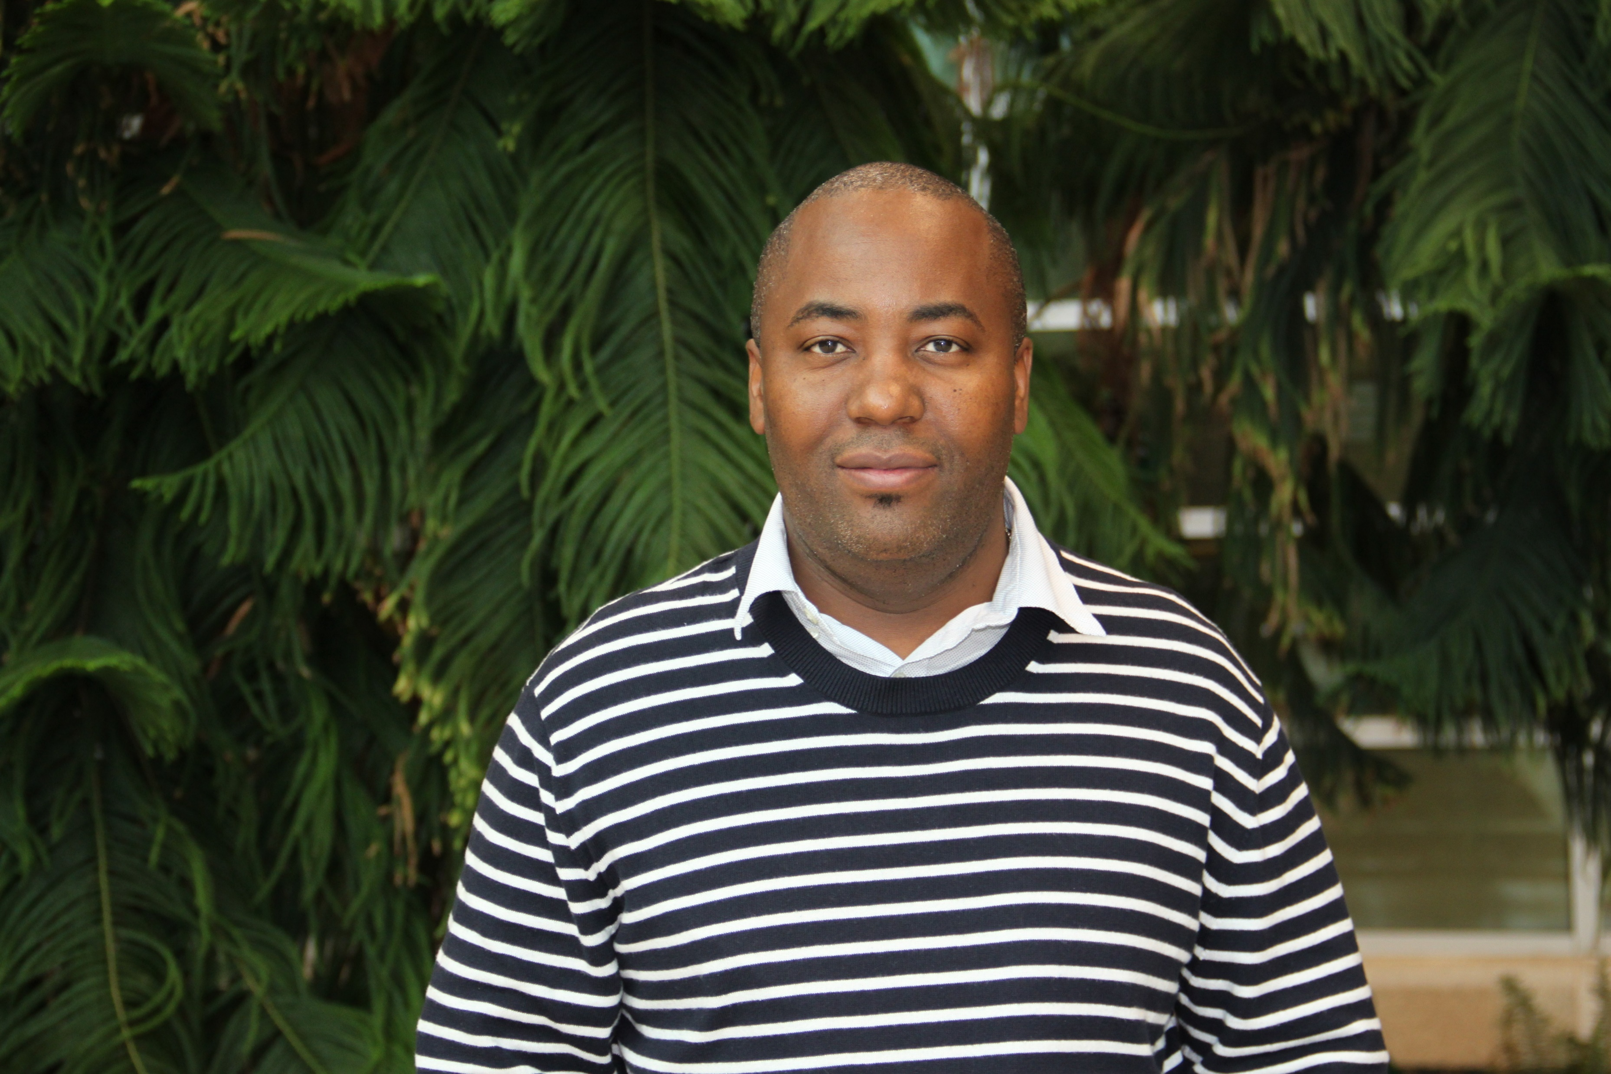
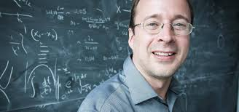
SIGNAL: SARS-CoV-2 Illumina GeNome Assembly Line
https://github.com/jaleezyy/covid-19-signal
Jalees Nasir
Finlay Maguire (Dalhousie)
Natalie Knox (PHAC)
Amos Raphenya
Kendrick Smith (Perimeter Institute)
Flowchart created by Emily Panousis

Slide 16
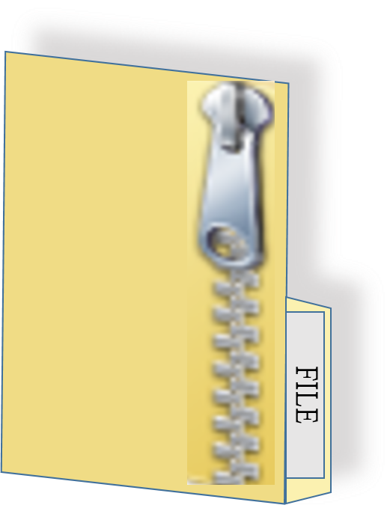
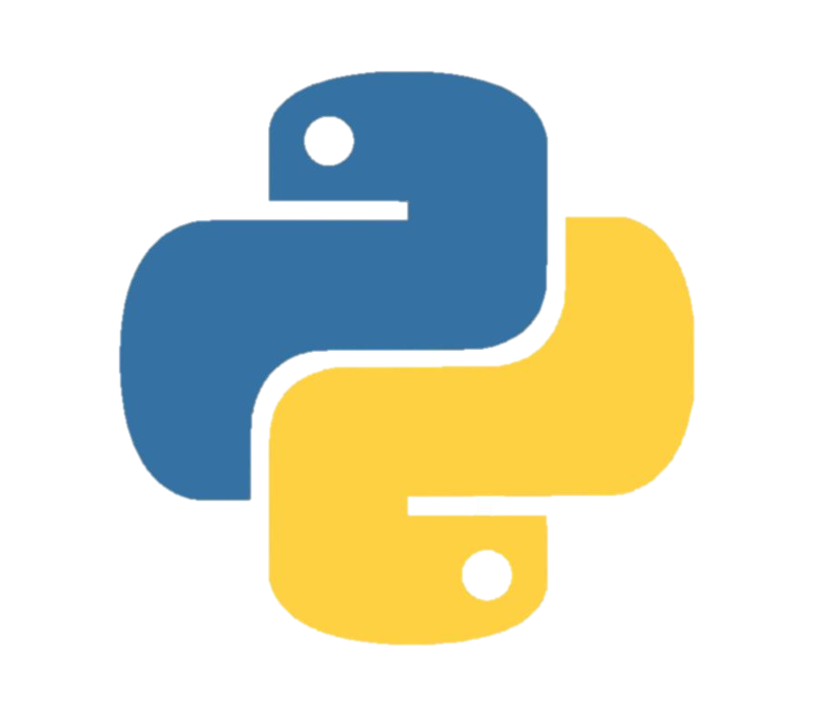

Workflow managers coordinate large amounts of data
Summary Files
-----------------------------------------
Results from a successful (or unsuccessful) run of SIGNAL.
summary.html
summary.zip
Illumina paired end sequencing reads sample#_R1.fastq.gz sample#_R2.fastq.gz
Pre-processing
Genome Assembly
Variant calling and lineage assessment
Quality control of reads and consensus sequence
snakemake.log File
-----------------------------------------
Contains all successful and unsuccessful output from snakemake.
Next sample
ERROR

Slide 17
Just how much work did we do… (2021)
Who/Where we supported?
Hamilton
Public Health Ontario overflow
London
Dynacare
Ottawa
Pearson Airport
Toronto (Sunnybrook & Mt. Sinai)
Brampton / Etobicoke
Windsor
North Bay & Sudbury via Canadore College
Institutional Outbreaks
Hamilton General
Juravinski
4,837+ genomes sequenced
2,800+ in GISAID
success rate >90%
often 6 days from swab to GISAID, sometimes <4 days
Until retrospective data dumps… (late 2020)
~20% of national data
~50% of Ontario data
Around the end of 2021…
~1-2% of national data
~6.3% of Ontario data

